Slide 1

Network Port Scanner GUI
Kayam Akshitha
AICTE ID : STU68b7d0142aaab1756876820

Slide 2

PROBLEM STATEMENT
Many port scanning tools are command-line based and difficult for beginners to use. There is a need for a simple graphical interface to easily identify open ports and understand network vulnerabilities.

Slide 3
Project Description The Network Port Scanner GUI is a Python-based tool that scans open ports on a target system using a user-friendly interface. Users can enter an IP address and port range to quickly identify active ports, making it useful for learning basic networking and security concepts.

Slide 4

WHO ARE THE END USERS?
Cybersecurity students
Beginners in ethical hacking
Network administrators
IT professionals

Slide 5

Technology Used
Python
Tkinter (GUI)
Socket Programming
Networking Concepts
Gemini

Slide 6
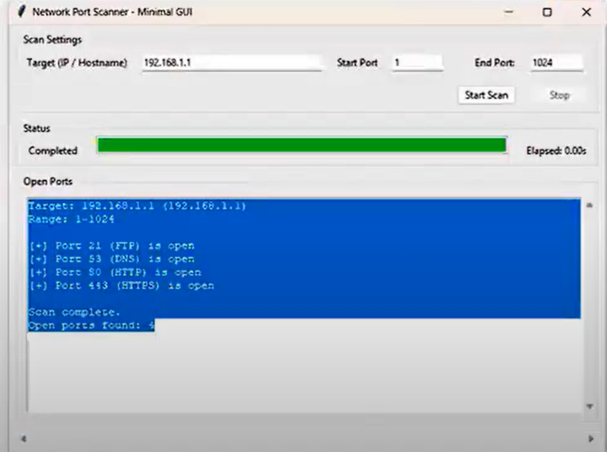
RESULTS
[Add screen shots of your code ]
Demo Link

Slide 7
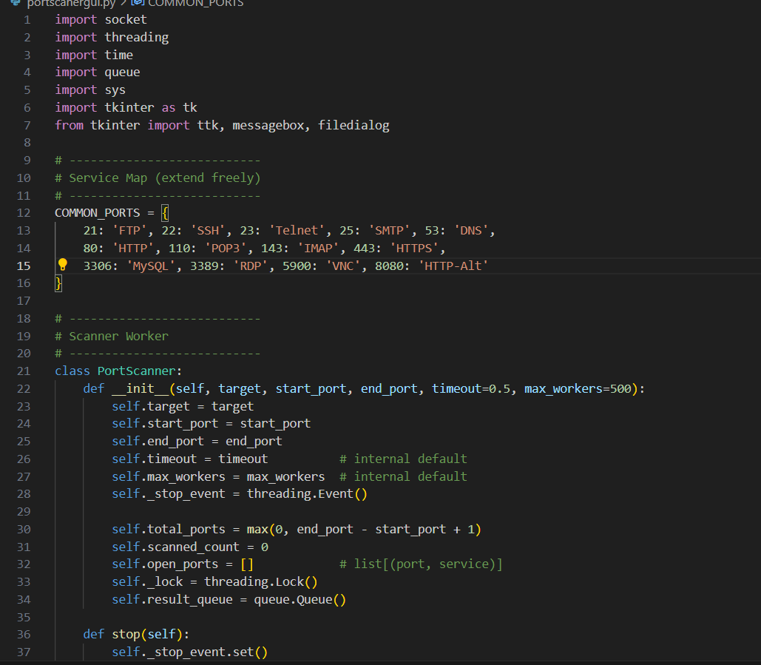
RESULTS
[Add screen shots of your code ]
Demo Link

Slide 8

Certificate - Protection from browser attacks

Slide 9

Certificate - Introduction to System Security

Slide 10
GitHub link
https://github.com/AKSHITHA-2109/Network-Port-Scanner-GUI.git

Slide 11
Thank you
Looking forward to your valuable feedback.
.
.

